Slide 1

CUSTOMER INSIGHTS & SALES PERFORMANCE DASHBOARD FOR A RETAIL BUSINESS
CAPSTONE PROJECT – END-TO-END DATA ANALYTICS FOR BUSINESS GROWTH
PRESENTED BY:
GUDIYA KUMARI SHARMA
ID : K-TECH-25-D8DD
B.TECH CSE (AIML)
ARKA JAIN UNIVERSITY
PROJECT UNDER :
IIT Kanpur Certified Data Analytics Program
Powered By :
K-Tech Learn & Prosper

Slide 2

Business Problem Understanding
The retail company faced several business challenges affecting growth and profitability.
Major Problems:
• Declining repeat customers
• Uneven sales across regions
• Low-performing product categories
• Lack of centralized dashboard for decision-making
Project Goal:
To analyze sales, customer behavior, and product performance data to generate actionable business insights and improve decision-making.

Slide 3
Dataset Overview
Dataset Name:
Sample Superstore Dataset
Dataset Size:
• 9,994 rows
• 21 columns
Key Features:
• Sales
• Profit
• Customer Segment
• Product Category
• Region
• Order Date
Tools Used:
• Python (Pandas, Matplotlib,
Scikit-learn)
• Power BI
• Google Colab

Slide 4

Key Insights Found
• Consumer segment generated highest sales revenue.
• Sales peaked during November and December.
• Technology category produced highest profit.
• Some regions contributed significantly higher sales.
• High-performing products should be prioritized for inventory planning.

Slide 5
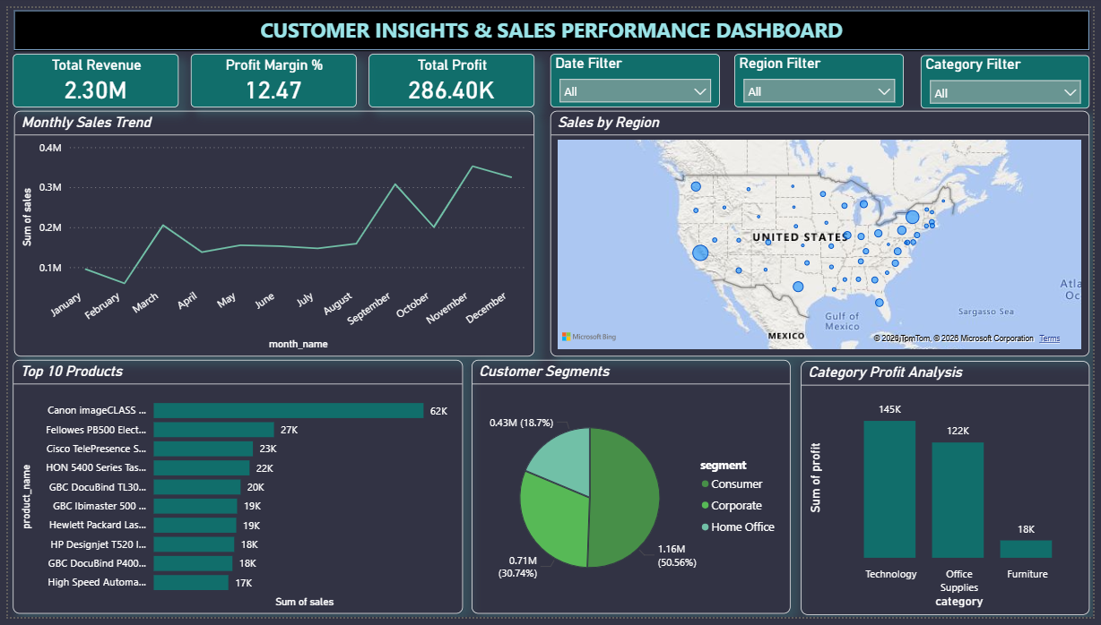
Interactive Dashboard Demo
Developed an interactive Power BI dashboard to visualize:
• Revenue & Profit KPIs
• Monthly sales trends
• Top-selling products
• Customer segmentation
• Region-wise sales performance
• Interactive filters

Slide 6
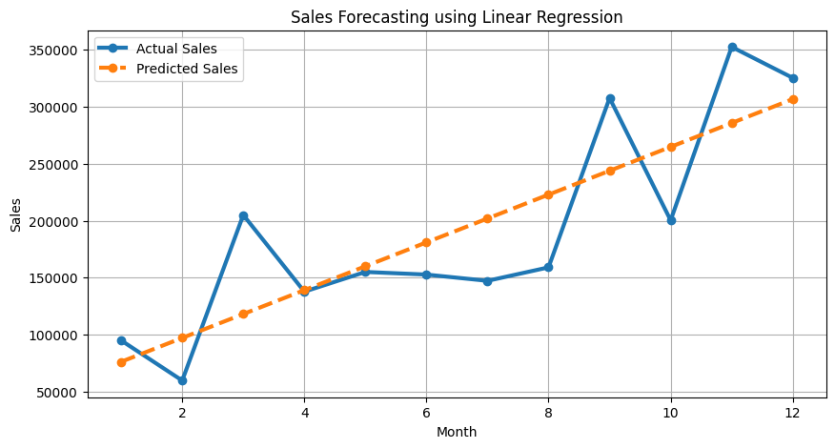
Predictive Analytics
Sales Forecasting using Linear Regression
A Linear Regression model was used to forecast future sales trends using monthly sales data.
Model Performance:
• R² Score: 0.67
Outcome:
• The model successfully identified future sales patterns and seasonal growth trends.
• Forecasting can help businesses improve inventory planning and sales strategies.

Slide 7
Business Recommendations
• Increase marketing efforts in high-performing regions.
• Launch loyalty programs to improve repeat purchases.
• Focus inventory on high-demand products.
• Reduce focus on low-profit product categories.
• Use dashboards for faster business decision-making.

Slide 8

ROI Impact of Recommendations
Expected Business Impact:
• Improved customer retention
• Increased regional sales performance
• Better inventory optimization
• Higher profitability from high-margin products
• Faster and data-driven management decisions

Slide 9
Thank you!

